Slide 1

Basic I/O System Design
Department of Computer Science & Engineering BRAC University.
Course ID: CSE - 341
Course Title: Microprocessors

Slide 2
Basic I/O System
A Microprocessor is a great tool for solving problem but is of little or no use if it can’t communicate with other devices.
Input-Output devices (or peripherals) such as Keyboards, Mouse, LEDs etc. are essential components of the microprocessor-based or microcontroller-based systems.
Input Devices
Receive data from peripheral (i.e., device)
Send data to processor
Output Devices
Receive data from processor
Send data to peripheral (i.e., device)

Slide 3
Basic I/O System
8086 processor uses address bus pins AD[15:0] to locate an I/O port
65,536 possible I/O ports
Data transfer between ports and the processor occurs over data bus
AL (or AX) is the processor register that takes input data (or provide output data)
Data bus
AL
8086
AAX
I/O
I/O
I/O
Address bus AD[15:0]

Slide 4
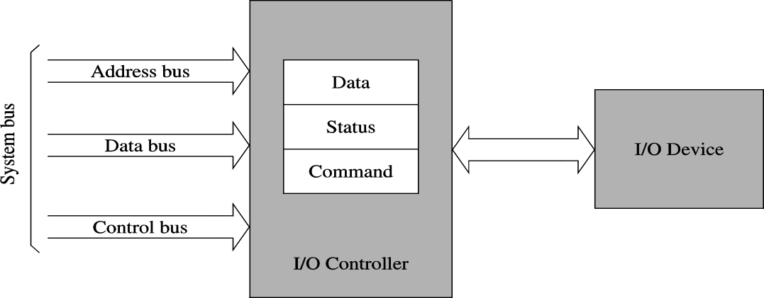
Basic I/O System
I/O devices serve two main purposes :
To communicate with outside world
To store and transfer data
I/O Controller is a microchip that acts as an interface between the systems bus and I/O device and helps to facilitate the flow of data between these devices. For e.g., 8255
Relieve the processor of low-level details
Takes care of electrical interface
I/O Controller Chips have three types of registers : Data, Command and Status

Slide 5
Basic I/O System
Read Operation: To receive binary data from an input peripheral
MPU places the address of an input port on the address bus to locate the I/O device, then it enables the input port by asserting the RD signal, and reads data using the data bus.
Write Operation: To send binary data to an output peripheral
MPU places the address of an output port on the address bus, places data on data bus, and asserts the WR signal to enable the output port.
Important Points:
Writing to the port : When the MPU sends out or transfers data to an output port
Reading from the port : When the MPU receives data from an input port
One port can be accessed at a time (Serial Interfacing)

Slide 6
I/O Instructions
I/O Instructions are commands given by the microprocessor to the I/O devices or peripherals in order to perform a specific task.
IN is the instruction that reads information from an I/O device.
OUT is the instruction that writes/sends data to an I/O device.
Data transfer takes place between the microprocessor accumulator (AL or AX) and the I/O device .
The I/O device may be identified using two methods:
Fixed address – A byte called p8 immediately following the opcode stores an 8 bit I/O address. This is called fixed because this is stored with the opcode in the ROM.
Variable address – Register DX holds a 16 bit I/O address. Because this can be changed.

Slide 7
I/O Instructions
IN AX, 25 - Here 25 (p8) refers to port 25 which is an 8 bit address
(direct format)
IN AL, DX - A byte input from the port addressed by DX into AL
IN AX, DX - A word input from the port addressed by DX into AX
(indirect format)
If p8 is used, only 8 bits are used thus the address or port number appears on lines A0-A7.
Hence, the first 2⁸ or 256 I/O port addresses (00H – FFH) are accessed by both fixed and variable I/O instructions.
If DX is used, then 16 bits are used thus the address or port number appears on lines A0-A15
Hence the addresses 0100H-FFFFH (257th address to 65535th address) are accessed only by variable I/O Address instructions.

Slide 8
Accessing I/O Devices
To establish a stable passage of communication between the CPU and the I/O devices, the peripherals must first be mapped to specific addresses so that they can accessed. Also to enable the flow of data the help of the system bus (address, data and control) is also required. This allocation of the system bus and mapping the I/O devices to addresses is performed in two different ways :
Memory-mapped I/O
Isolated I/O

Slide 9
I/O Address Mapping
 Memory Mapped I/O
A part of the memory is used to map I/O devices
A device is mapped to a memory location. Sending data to the particular location causes interaction with the device.
Common address, data and control lines for both memory and I/O
Uses same memory read and write signals for memory and I/O
Most processors use this I/O mapping
Memory addressing
space
FFFFF
I/O
y
x
00000

Slide 10
I/O Address Mapping
Memory Mapped I/O
Advantages :
Less complication
Less circuitry
Same instructions such as MOV can be used for both memory and I/O
Less decoding
.
Disadvantages :
A portion of the memory system is used as the I/O Map

Slide 11
I/O Address Mapping
Isolated I/O
Separate I/O address space
Common data and address bus for peripherals, CPU and memory
But separate or isolated control signals for I/O and memory.
IORC and (IOWC) signals are for I/O devices.
MEMR and MEMW signals are for memory
This is the most common form of I/O transfer technique used with Intel processors and PC.
Pentium supports isolated I/O of 64 KB address space.
FFFFF
Memory addressing space
00000
FFFF
I/O addressing space
0000

Slide 12
I/O Address Mapping
Isolated I/O
Advantages:
In this system no memory is wasted for I/O mapping.
Disadvantages:
Separate signals are also needed to interact with the I/O devices which separate it from normal memory access instructions.
Instructions IN and OUT need to be used to perform data transfer.

Slide 13
Accessing I/O Devices in 8086
Addressing Space
Accessing directly by instructions
FFFF
IN | AL, | 80 H
IN | AX, | 6 H
OUT | 3C H, | AL
OUT | A0 H, | AX
Accessed through DX
Accessing through DX
00FF
00F8
IN AX, DX
OUT DX, AL
OUT DX, AX
Accessed directly by instructions
0000

Slide 14
I/O Data Transfer Techniques
Different ways of transfer of data between the CPU and the I/O devices, namely:
Programmed I/O
Interrupt-driven I/O
Direct memory access (DMA)

Slide 15
Programmed I/O
Transfer of data between CPU and I/O using programmed I/O:
Invoke read / write command to peripheral
Check ready status of I/O device
If not ready, continue checking status until ready
If ready, initiate operation
Thus transfer of data takes place
Key points to remember:
CPU waits for I/O device to complete the operation if its not ready
Programmed I/O Wastes CPU time
CPU performance is degraded
Now to improve this situation to some extent, we will use Interrupt-Driven I/O


Slide 16
Interrupt-driven I/O
Transfer of data between CPU and I/O using programmed I/O:
Invoke read / write command to peripheral
Now instead of waiting for I/O device, it continues it’s other tasks
I/O device when ready, gives an Interrupt signal to CPU signaling its ready for data transfer
Since I/O device is ready ready, operation is initiated.
Thus transfer of data takes place
Key points to remember:
CPU does not continuously wait for I/O device
I/O device itself alerts the CPU when it is ready
CPU performance is better than programmed I/O
But there is still room for making CPU performance more efficient

Slide 17
Why do we require an alternate?
Interrupt driven and programmed I/O require active CPU intervention.
Makes the CPU wait
Requires CPU’s attention during data transfer
CPU is tied up and processing time is being wasted
DMA is the answer

Slide 18
Direct Memory Access (DMA)
Direct Memory Access (DMA) is a process of data transfer between the memory
and I/O devices. An external device takes over the control of system bus from the
CPU and facilitates with the data transfer.
The basic idea of DMA is to transfer blocks of data directly between memory and peripherals. The data does not have to go through the microprocessor.
DMA controller can perform this task, relieving the CPU from the burden of transferring data.
The CPU just issues the command for data transfer and shift its focus on actual data processing while the DMA handles the transfer of data
Can be used for high-speed data transfer between memory and peripherals such as HDD, magnetic tape etc.
Nowadays, DMA can transfer data as fast as 40-60 M byte per second.

Slide 19
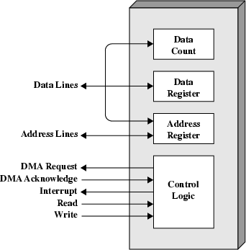
DMA Controller
A DMA controller is connected with several peripherals that may request DMA.
The controller can decides the priority of the DMA requests, can communicate with the I/O devices and the CPU, and provides memory addresses for data transfer.
For e.g. the Intel 8237 is a DMA controller
It is a 4-channel device. Each channel is dedicated to a specific I/O device
It is capable of addressing 64KB section of memory
Typical DMA Module Diagram

Slide 20
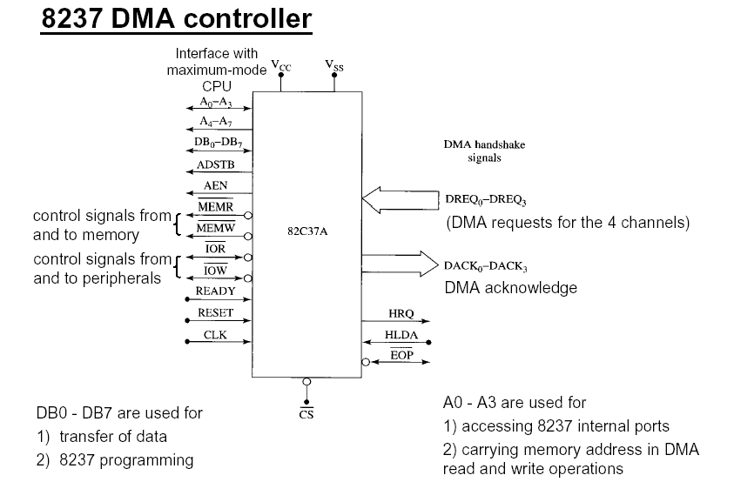
8237 DMA Controller

Slide 21
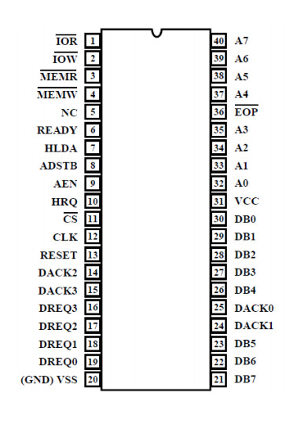
8237 DMA Controller
Pin Description:
DREQ3 – DREQ0 (DMA channel request): Used to request a DMA transfer from a particular DMA channel.
DACK3 – DACK0 (DMA channel acknowledge): Acknowledges a channel DMA request from a device.
HRQ (Hold request): Requests control of the system bus to the CPU.
HLDA (Hold acknowledge): Signals the 8237 that the microprocessor has acknowledged the hold request and relinquished control of the system bus.

Slide 22
8237 DMA Controller
AEN (Address enable): Enables the DMA address latch connected to the 8237 (Use to take the control of the address bus from the microprocessor)
ADSTB (Address strobe): It is used to latch the higher 8 bits of the address during DMA operation.
EOP (End of process): It is a bi directional pin that signals the end of the DMA process.
IOR (I/O read): A bi-directional pin which the CPU can use to read data from the internal registers of 8237 and can be used as an output to read data from a peripheral during a DMA write cycle.

Slide 23
8237 DMA Controller
IOW (I/O write A bi-directional pin which the CPU can use to write data to the internal registers of 8237 and can be used as an output strobe to write data to a peripheral during a DMA read cycle.
MEMW (Memory write): Used to write data to the selected memory during a DMA write cycle.
MEMR (Memory read): Used to read data from the selected memory during a DMA read cycle.
A3 – A0: They are bi directional pins. They can be used to select the internal registers of the 8237 by the CPU . Otherwise holds the lower nibble of the lower 8 bits of the memory address from where data is to be read / write during DMA operation.

Slide 24
8237 DMA Controller
A7 – A4: Used to provide the higher nibble of the lower 8 bits of the memory address from where data is to be read / write during DMA operation.
DB0 – DB7: Carries data during data transfer. Otherwise stores the higher 8 bits of the memory address from where data is to be read / write during DMA operation.

Slide 25
DMA Operation
CPU invokes a read/write command to the peripherals
The peripherals when ready sends a DMA request (DREQ) signal to the DMA controller
The DMA controller sends a Hold Request (HRQ) signal to the CPU to gain control of the system bus
The CPU replies with a Hold Acknowledgement signal to the DMA giving the DMA controller total control over the system bus
The DMA controller then sends a DMA Acknowledgement signal to the peripherals in reply to the previous DMA request signal
Data can now be transferred between Memory and I/O with the help of the DMA controller
DMA controller sends interrupt signal to the CPU when finished with data transfer.
The DMA disables the DMA Acknowledgement signal and the CPU disables the Hold Acknowledgement signal taking back control of the system bus.

Slide 26
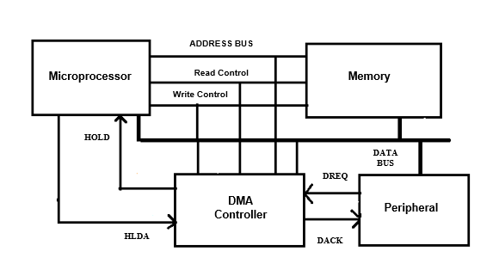
DMA Operation
Fig : Simplified Block Diagram of a DMA Operation

Slide 27
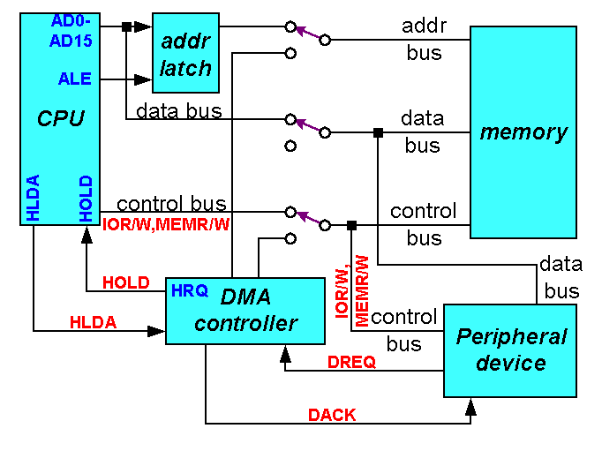
DMA Operation
When the CPU is Bus Master

Slide 28

DMA Operation
When DMA takes control

Slide 29
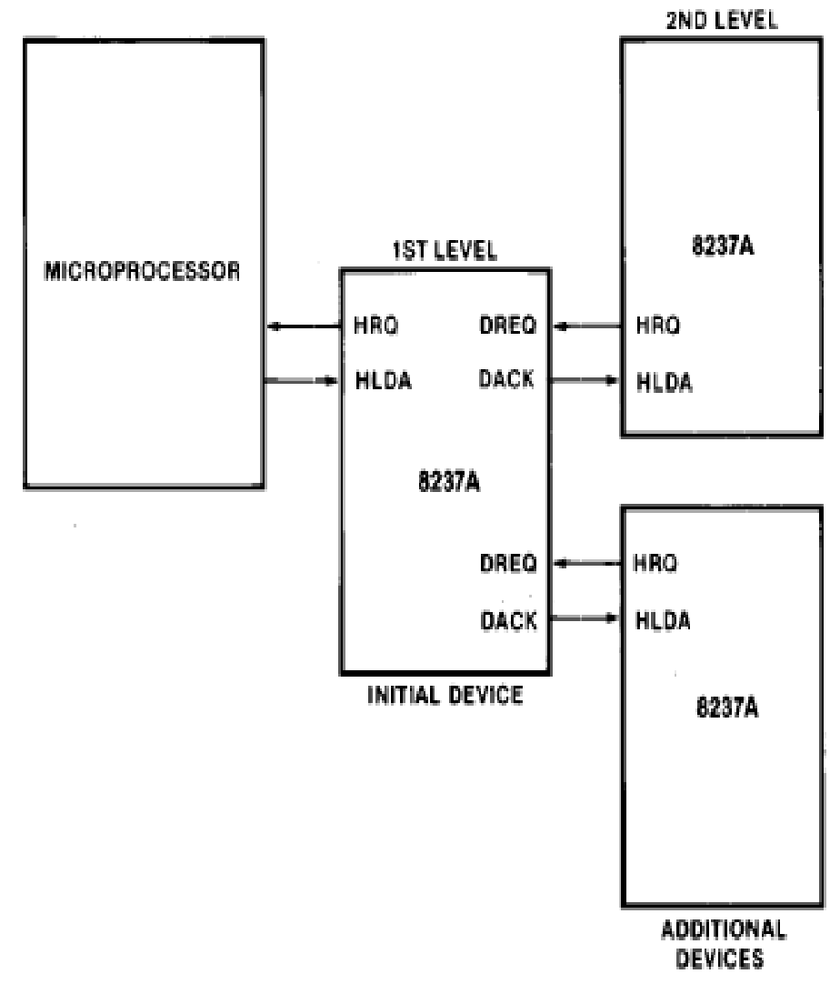
DMA Cascade Mode
Using this method more than one 8237 DMA Controller can be connected.
This can be adopted to get the utility of more than 4 channels
The HRQ and HLDA signals from the additional controllers are connected with the DREQ and DACK pins of the primary or “Host” controller
It is the responsibility of the host to prioritize and co ordinate the secondary controllers.

Slide 30
Thank You !!

